Slide 1

Maps
"He's off the map!"
-Stan (Mark Ruffalo) Eternal Sunshine of the Spotless Mind

Slide 2
Other Data Structures
Write a program to count the frequency of all the words in a file.
Make a simplification: assume words are anything set off by whitespace
Maps

Slide 3
Why So Slow
Write a contains method for an array based list
public boolean contains(E target) {
CS 314
Maps

Slide 4
A Faster Way - Maps
Also known as:
  table, search table, dictionary, associative array, or associative container
A data structure optimized for a very specific kind of search / access
In a map we access by asking "give me the value associated with this key."
Recall, in the ArrayList example we did not count the number of occurrences of each word
CS 314
Maps

Slide 5
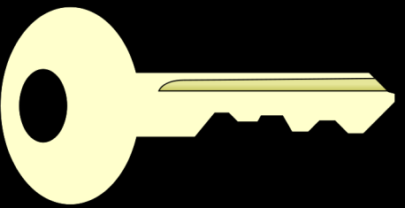
Keys and Values
Dictionary Analogy:
  The key in a dictionary is a word:
  foo
  The value in a dictionary is the definition:
  First on the standard list of metasyntactic variables used in syntax examples
A key and its associated value form a pair that is stored in a map
To retrieve a value the key for that value must be supplied
  A List can be viewed as a Map with integer keys
CS 314
Maps

Slide 6
More on Keys and Values
Keys must be unique, meaning a given key can only represent one value
  but one value may be represented by multiple keys
  like synonyms in the dictionary.
  Example:
  factor: n.See coefficient of X
  factor is a key associated with the same value (definition) as the key coefficient of X
CS 314
Maps

Slide 7
The Map<K, V> Interface in Java
void clear()
  Removes all mappings from this map (optional operation).
boolean containsKey(Object key)
  Returns true if this map contains a mapping for the specified key.
boolean containsValue(Object value)
  Returns true if this map maps one or more keys to the specified value.
Set<K> keySet()
  Returns a Set view of the keys contained in this map.
CS 314
Maps

Slide 8
The Map Interface Continued
V get(Object key)
  Returns the value to which this map maps the specified key.
boolean isEmpty()
  Returns true if this map contains no key-value mappings.
V put(K key, V value)
  Associates the specified value with the specified key in this map
CS 314
Maps

Slide 9
The Map Interface Continued
V remove(Object key)
  Removes the mapping for this key from this map if it is present
int size()
  Returns the number of key-value mappings in this map.
Collection<V> values()
  Returns a collection view of the values contained in this map.
CS 314
Maps

Slide 10

Other Uses?
Maps

